Slide 1

City of West Point Proposed Budget
2024

Slide 2
Current 2023 Budget
Department | Budget | Fiscal Activity | Percent Used
General Government | $1,067,000.00 | $842,372.45 | 78.95%
Police | $1,946,200.00 | $1,493,150.04 | 76.72%
Fire | $1,579,334.51 | $1,241,466.50 | 78.61%
Public Works | $951,888.00 | $758,235.87 | 79.66%
Planning & Zoning | $369,900.00 | $313,178.31 | 84.67%
Economic Development | $249,700.59 | $161,398.27 | 64.64%
911 Communication | $362,670.00 | $296,024.64 | 81.62%
Water & Sewer | $4,015,145.00 | $3,577,465.89 | 89.00%
Electric | $8,161,372.00 | $6,299,269.54 | 77.18%
Gas | $1,627,435.76 | $983,243.56 | 60.42%
Sanitition | $555,950.00 | $423,327.61 | 76.14%

Slide 3
Current Debt
General Government
Fire Station $2,954,781.00
Utilities
Water/Sewer$20,104,539.45
Gas $1,291,808.00

Slide 4
Budget Planning
Department 5-Year Strategic Planning 2024- 2028
General Government Operational Needs - $15 Million
Utility Operational Needs - $23 Million

Slide 5
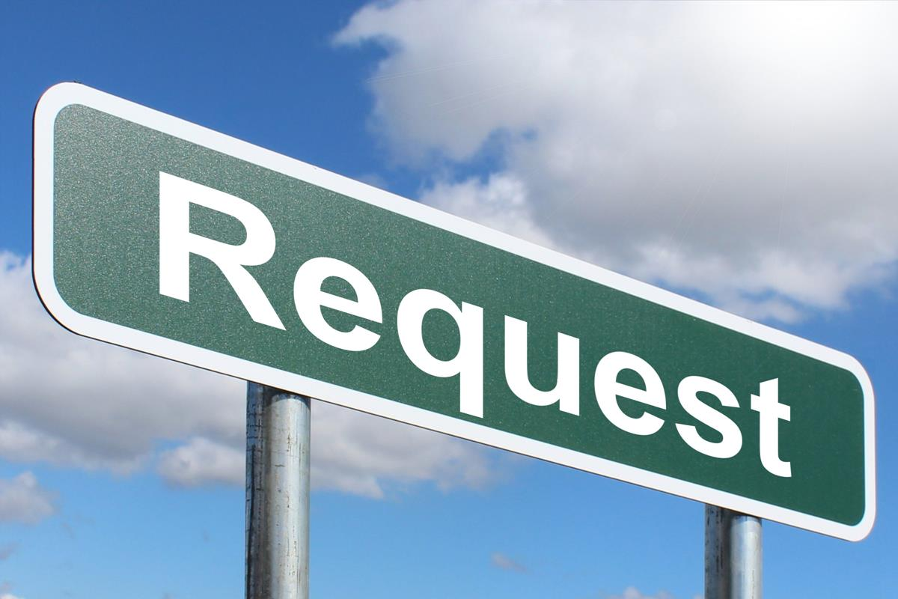
2024 General Fund and Utilities Request
Operations
Staff 18
Capital
11Vehicle
Fire Engine
Ambulance
2 Tractors
Digger Derrick Truck
Grapple Truck
Roll Off Truck

Slide 6
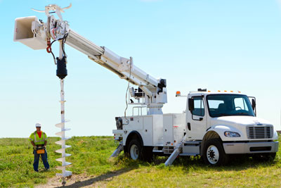
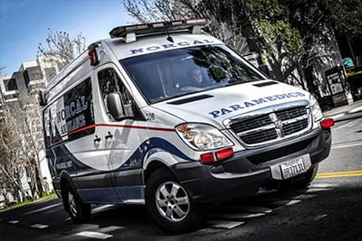
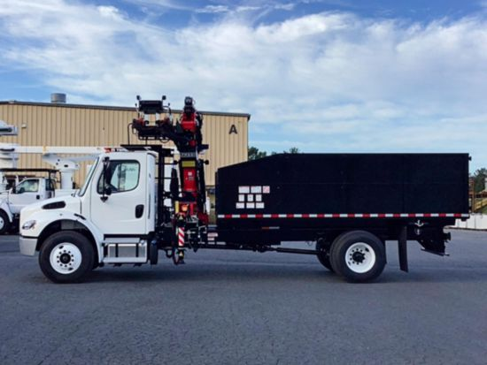

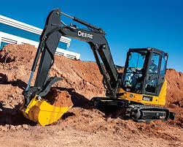
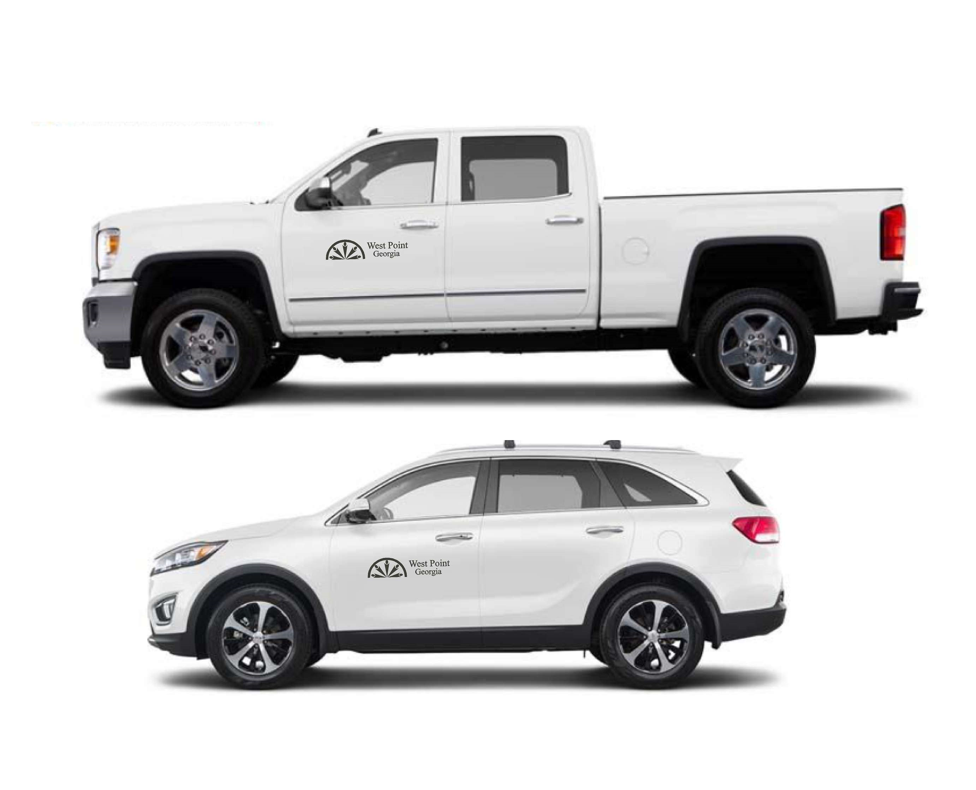
$1 Million
Capital Budget

Slide 7


8 New Staff Positions 2024
1 GG
1 PD
1 FD/EMS
1 PW
2 911
1 Utilities

Slide 8

2024 Cost Increases
COLA 6%
Materials and Supplies
Fuel
Utilities
Services
Contract Work
Water and Sewer Rate 6%
Garbage 6%
Roadside Collection $.50

Slide 10
2024 Proposed Budget
GENERAL GOVERNMENT |  |  |  | $1,521,937.97
POLICE |  |  |  | $2,359,137.03
FIRE |  |  |  | $1,920,700.00
911 TRANSFER |  |  |  | $326,450.00
HIGHWAYS AND STREETS |  |  |  | $1,340,100.00
VCB COMMUNITY CENTER |  |  |  | $12,700.00
RECREATION & PARKS |  |  |  | $106,000.00
PLANNING AND ZONING |  |  |  | $442,150.00
ECONOMIC DEVELOPMENT |  |  |  | $327,550.00
SPECIAL FACILITIES DEPOT |  |  |  | $92,425.00
YOUTH SERVICES |  |  |  | $97,700.00
STUDY / TECHNOLOGY CENTER |  |  |  | $87,950.00
 |  |  | Total: | $8,634,800.00
SEWAGE COLLECTION AND DISPOSAL |  |  |  | $297,561.00
SEWAGE TREATMENT PLANTS |  |  |  | $1,280,495.06
WATER |  |  |  | $2,348,060.00
 |  |  | Total: | $3,926,116.06
ELECTRIC |  |  |  | $12,543,840.00
GAS |  |  |  | $1,257,726.00
SANITATION |  |  |  | $510,350.00
911 COMMUNICATION |  |  |  | $422,550.00
SPLOST |  |  |  | $1,138,000.00
 |  |  | Total Budget: | $28,433,382.06

Slide 11
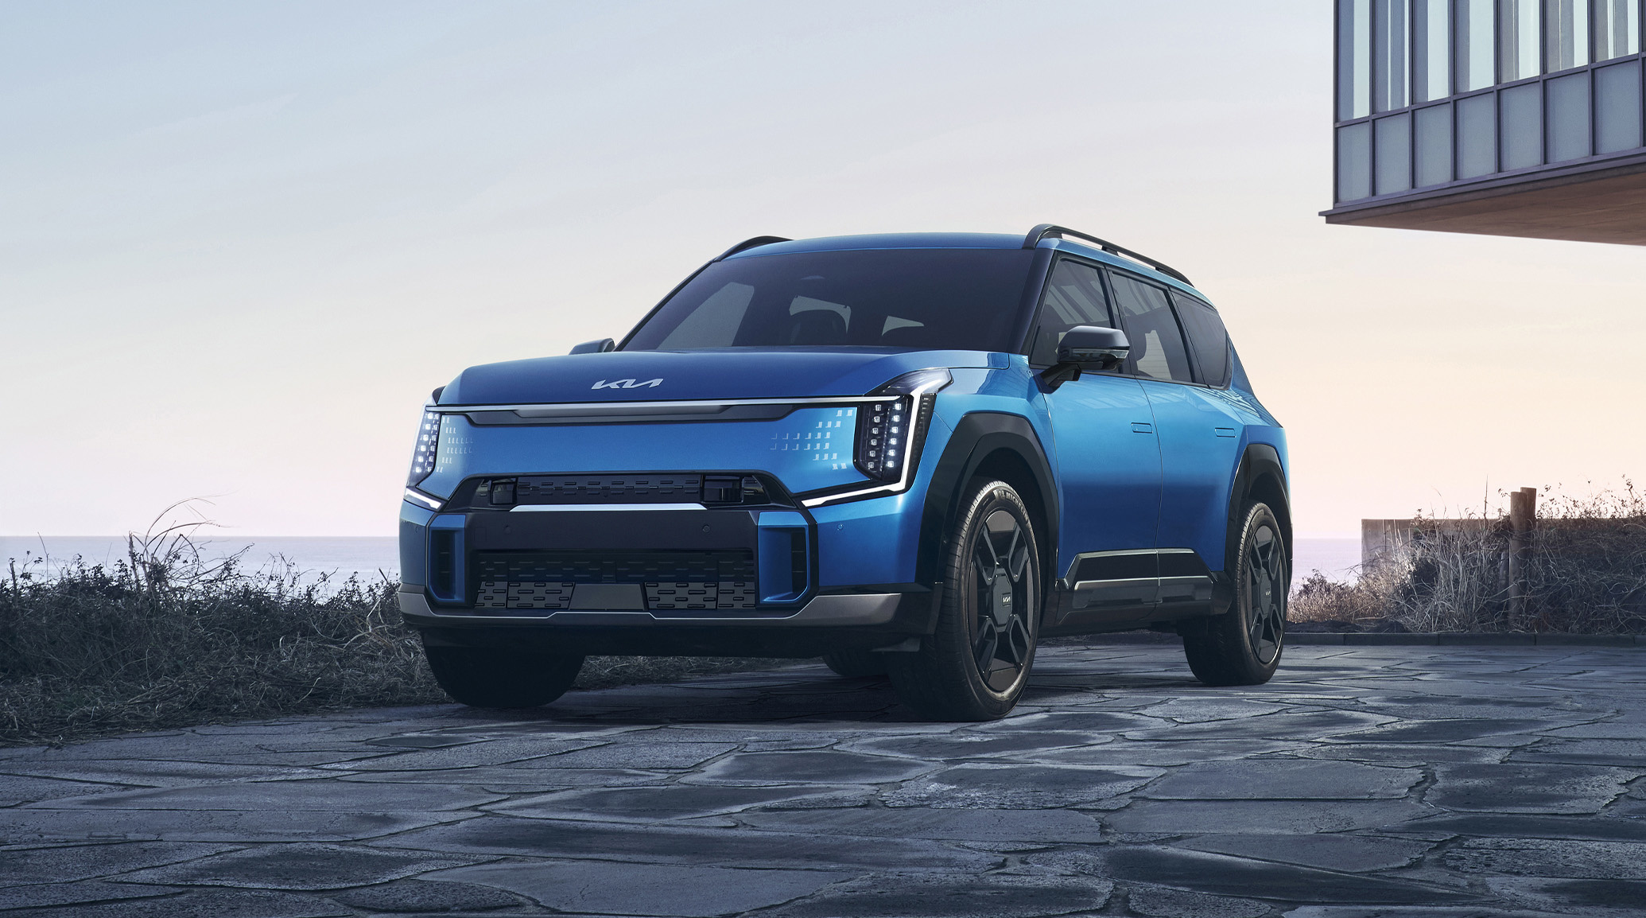
Big Things for 2024
Kia Georgia EV9
Daesol Ausys
Brent Holdings Mixed Use Development
Loves Country Store with Hardees Restaurant
Completion of Exit 2 Roundabouts
Villages at Harris Creek Units 3&4
Water Intake and Plant Improvements

Slide 12
Proposed 2024 Budget $28,433,382.06
Questions

